Slide 1
Stack MCQs

Slide 2
Suppose a stack is to be implemented with a linked list instead of an array. What would be the effect on the time complexity of the push and pop operations of the stack implemented using linked list (Assuming stack is implemented efficiently)?
(A) O(1) for insertion and O(n) for deletion (B) O(1) for insertion and O(1) for deletion
(C) O(n) for insertion and O(1) for deletion
(D) O(n) for insertion and O(n) for deletion

Slide 3
Suppose a stack is to be implemented with a linked list instead of an array. What would be the effect on the time complexity of the push and pop operations of the stack implemented using linked list (Assuming stack is implemented efficiently)?
(A) O(1) for insertion and O(n) for deletion (B) O(1) for insertion and O(1) for deletion
(C) O(n) for insertion and O(1) for deletion
(D) O(n) for insertion and O(n) for deletion
Answer: (B) Explanation: Stack can be implemented using link list having O(1) bounds for both insertion as well as deletion by inserting and deleting the element from the beginning of the list.

Slide 4
ISRO | ISRO CS 2017 – May | Question 57
The best data structure to check whether an arithmetic expression has balanced parenthesis is a (A) Queue (B) Stack (C) Tree (D) List

Slide 5
ISRO | ISRO CS 2017 – May | Question 57
Last Updated: 21-03-2018 The best data structure to check whether an arithmetic expression has balanced parenthesis is a (A) Queue (B) Stack (C) Tree (D) List Answer: (B) Explanation: Stacks can check equal pair/ balanced pair of parenthesis efficiently. Whenever we get an opening parenthesis we can push it on the stack and when we get the corresponding closing parenthesis, we can pop it. After performing all push and pop operations, if at the end of the expression stack becomes empty then the expression has a balanced parenthesis.

Slide 6
Data Structures | Stack | Question 8 (GATE CS 2004)
A single array A[1..MAXSIZE] is used to implement two stacks. The two stacks grow from opposite ends of the array. Variables top1 and top2 (topl< top 2) point to the location of the topmost element in each of the stacks. If the space is to be used efficiently, the condition for “stack full” is
(A) (top1 = MAXSIZE/2) and (top2 = MAXSIZE/2+1) (B) top1 + top2 = MAXSIZE (C) (top1= MAXSIZE/2) or (top2 = MAXSIZE) (D) top1= top2 -1

Slide 7
Data Structures | Stack | Question 8 (GATE CS 2004)
A single array A[1..MAXSIZE] is used to implement two stacks. The two stacks grow from opposite ends of the array. Variables top1 and top2 (topl< top 2) point to the location of the topmost element in each of the stacks. If the space is to be used efficiently, the condition for “stack full” is
(A) (top1 = MAXSIZE/2) and (top2 = MAXSIZE/2+1) (B) top1 + top2 = MAXSIZE (C) (top1= MAXSIZE/2) or (top2 = MAXSIZE) (D) top1= top2 -1 Answer: (D) Explanation: If we are to use space efficiently then size of the any stack can be more than MAXSIZE/2. Both stacks will grow from both ends and if any of the stack top reaches near to the other top then stacks are full. So the condition will be top1 = top2 -1 (given that top1 < top2)

Slide 8
UGC-NET | UGC NET CS 2017 Jan – II | Question 22
The seven elements A, B, C, D, E, F and G are pushed onto a stack in reverse order, i.e., starting from G. The stack is popped five times and each element is inserted into a queue. Two elements are deleted from the queue and pushed back onto the stack. Now, one element is popped from the stack. The popped item is ________. (A) A (B) B (C) F (D) G

Slide 9
UGC-NET | UGC NET CS 2017 Jan – II | Question 22
The seven elements A, B, C, D, E, F and G are pushed onto a stack in reverse order, i.e., starting from G. The stack is popped five times and each element is inserted into a queue. Two elements are deleted from the queue and pushed back onto the stack. Now, one element is popped from the stack. The popped item is ________. (A) A (B) B (C) F (D) G Answer: (B)

Slide 10
ISRO | ISRO CS 2015 | Question 11
If the sequence of operations – push (1), push (2), pop, push (1), push (2), pop, pop, pop, push (2), pop are performed on a stack, the sequence of popped out values (A) 2,2,1,1,2 (B) 2,2,1,2,2 (C) 2,1,2,2,1 (D) 2,1,2,2,2

Slide 11
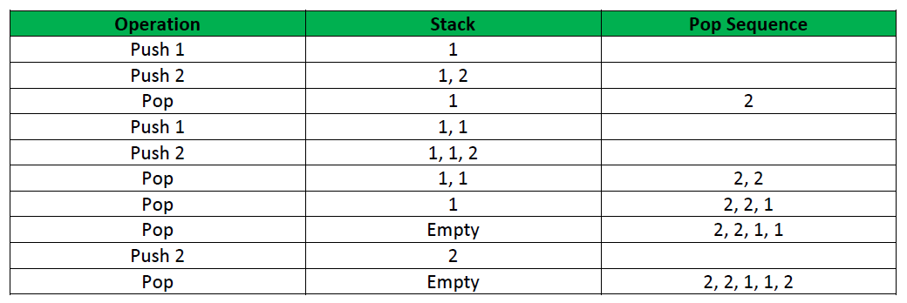
ISRO | ISRO CS 2015 | Question 11
If the sequence of operations – push (1), push (2), pop, push (1), push (2), pop, pop, pop, push (2), pop are performed on a stack, the sequence of popped out values (A) 2,2,1,1,2 (B) 2,2,1,2,2 (C) 2,1,2,2,1 (D) 2,1,2,2,2 Answer: (A) Explanation: The pop sequence can be seen from the following table:

Slide 12
ISRO | ISRO CS 2017 | Question 47
Which of the following permutation can be obtained in the same order using a stack assuming that input is the sequence 5, 6, 7, 8, 9 in that order? (A) 7, 8, 9, 5, 6 (B) 5, 9, 6, 7, 8 (C) 7, 8, 9, 6, 5 (D) 9, 8, 7, 5, 6

Slide 13
ISRO | ISRO CS 2017 | Question 47
Which of the following permutation can be obtained in the same order using a stack assuming that input is the sequence 5, 6, 7, 8, 9 in that order? (A) 7, 8, 9, 5, 6 (B) 5, 9, 6, 7, 8 (C) 7, 8, 9, 6, 5 (D) 9, 8, 7, 5, 6 Answer: (C) Explanation: The sequence given in option (C) is one of the only possible sequence which can be obtained. We can obtain the sequence by performing operations in the manner: Push 5 Push 6 Push 7 Pop 7 Push 8 Pop 8 Push 9 Pop 9 Pop 6 Pop 5. hence the sequence will be 7,8,9,6,5.

Slide 14
UGC-NET | UGC NET CS 2016 July – II | Question 22
Consider the following operations performed on a stack of size 5 : Push (a); Pop() ; Push(b); Push(c); Pop(); Push(d); Pop();Pop(); Push (e) Which of the following statements is correct? (A) Underflow occurs (B) Stack operations are performed smoothly (C) Overflow occurs (D) None of the above

Slide 15
UGC-NET | UGC NET CS 2016 July – II | Question 22
Consider the following operations performed on a stack of size 5 : Push (a); Pop() ; Push(b); Push(c); Pop(); Push(d); Pop();Pop(); Push (e) Which of the following statements is correct? (A) Underflow occurs (B) Stack operations are performed smoothly (C) Overflow occurs (D) None of the above Answer: (B)

Slide 16
UGC-NET | UGC NET CS 2016 July – II | Question 24
Which of the following is not an inherent application of stack? (A) Implementation of recursion (B) Evaluation of a postfix expression (C) Job scheduling (D) Reverse a string

Slide 17
UGC-NET | UGC NET CS 2016 July – II | Question 24
Which of the following is not an inherent application of stack? (A) Implementation of recursion (B) Evaluation of a postfix expression (C) Job scheduling (D) Reverse a string Answer: (C) Explanation: We can use stack for string reversal, evaluation of postfix expression and most important is implementation of recursion but job scheduling is not done by stack. So, option (C) is correct.

Slide 18
ISRO | ISRO CS 2008 | Question 67
Stack A has the entries a, b, c (with a on top). Stack B is empty. An entry popped out of stack A can be printed immediately or pushed to stack B. An entry popped out of the stack B can be only be printed. In this arrangement, which of the following permutations of a, b, c are not possible?
(A) b a c
(B) b c a
(C) c a b
(D) a b c

Slide 19
ISRO | ISRO CS 2008 | Question 67
Stack A has the entries a, b, c (with a on top). Stack B is empty. An entry popped out of stack A can be printed immediately or pushed to stack B. An entry popped out of the stack B can be only be printed. In this arrangement, which of the following permutations of a, b, c are not possible?
(A) b a c
(B) b c a
(C) c a b
(D) a b c
Answer: (C)
Explanation:
Option (A):
Pop a from stack A
Push a to stack B
Print b
Print a from stack B
Print c from stack A
Order = b a c
Option (B):
Pop a from stack A
Push a to stack B
Print b from stack A
Print c from stack A
Print a from stack A
Order = b c a
Option (C):
Pop a from stack A
Push a to stack B
Pop b from stack A
Push b to stack B
Print c from stack A
Now, printing a will not be possible.

Slide 20
GATE | GATE-CS-2002 | Question 44
To evaluate an expression without any embedded function calls: (A) One stack is enough (B) Two stacks are needed (C) As many stacks as the height of the expression tree are needed (D) A Turing machine is needed in the general case

Slide 21
GATE | GATE-CS-2002 | Question 44
To evaluate an expression without any embedded function calls: (A) One stack is enough (B) Two stacks are needed (C) As many stacks as the height of the expression tree are needed (D) A Turing machine is needed in the general case Answer: (A) Explanation: Any expression can be converted into Postfix or Prefix form. Prefix and postfix evaluation can be done using a single stack.

